Slide 1
Introduction to CSS

Slide 2

Hello!
I am Justin Estaris
CSS and JavaScript Mentor in Hack Club
You can find me at @JustinEstaris

Slide 3
Itinerary
Introduction to CSS
Advanced CSS
Bootstrap 4 & Templates

Slide 4
Itinerary
CSS Grid
CSS Layout
Prize Winner

Slide 5
1.
Introduction to CSS
Properties
Selectors
Text & Font
Images
Box Model
Px vs Em vs Rem

Slide 6
Your First CSS

Slide 7
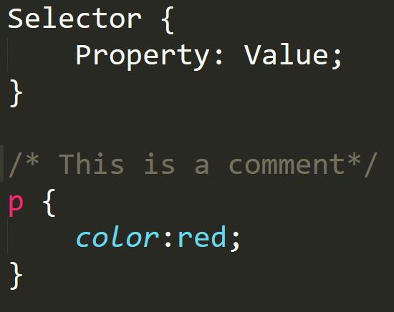
CSS General Rule & Commenting
Notes:
The general rule is that you use identify the selector on HTML and pick the property whose value you want to change.
/* */ Is how you comment in CSS
Show example of changing text colour in Sublime

Slide 8
Linking CSS into your HTML Page
Notes:
How does the HTML File know that the CSS file exists?
You put the file in the HEAD tag
Rel = what relationship will this link have
Type = Media Type
Change the background color to a different colour to check if the CSS file is linked with the HTML Page.
Be sure to be careful with the href url. Make sure that it leads into the CSS page relative to the HTML File

Slide 9
What’s the full name of CSS?
CSS: Cascading Style Sheets
Cascading: It will always take the selector that is at the end*
More on this Cascading property later on.
Notes:
Cascading means that the page will always take the selector that is at the end. There’s more to it, but for now it just means it will take the selector that is at the end.
Demonstrate by doing 2 different p-tags that change the color in the same style sheet.
Showcase Chrome Inspector Tool for CSS Capabilities

Slide 10
CSS Properties

Slide 11
How many CSS properties are there?
Too Many
Notes:
To showcase how many CSS properties there are go to css-tricks.com -> almanc
We’ll focus on the ones you’ll encounter most often

Slide 12
We’ll focus on the ones you’ll encounter most often
Text-align
Border
Background-image
Background-size
List-style
Cursor
Display
Notes:
To showcase how many CSS properties there are go to css-tricks.com -> almanc
We’ll focus on the ones you’ll encounter most often:
Text-align - aligns the text (left, right, center)
Border: 5px dashed purple -> 5px size of the border, style of border, colour of the border
Background-image: url(background-image.jpg) - Applies a background image
Can also add links
Image Doesn’t fit the screen
Background-size: cover; - Adjusts the background size to fit the screen
List-style: none - removes the bullet points
Cursor - Changes what the cursor will look like
Display - Determines how the element behaves
Block
Inline-Block
Inline
Order CSS. Generalized Tags the top; Specific tags more at the bottom

Slide 13
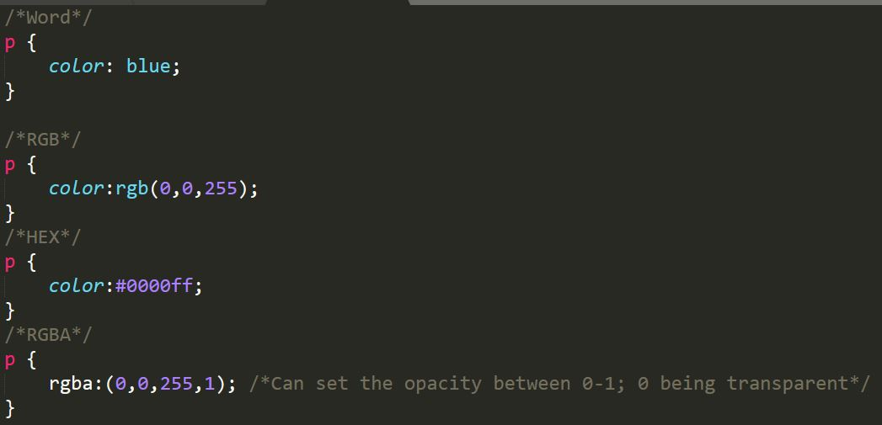
Changing Colours in CSS
Word
RGB
HEX
RGBA
Notes:
Example file given: changing-colors.css
Getting a Palette Picker is a great way to find nice colours to use with

Slide 14
Selectors

Slide 15
Selector Types
Cheat Sheet Provided!
.class
#id
*
Element
Element, element
Element element
Element > element
Element + element
:hover
:last-child
:first-child
!important

Slide 16
What selectors win out?
It depends on 3 factors:
Specificity
Importance
Source Order
Notes:
Showcase specificity calculator

Slide 17
Text & Font

Slide 18
Text Properties
Text-decoration
Text-transform
Line-height
Font-style
Font-weight
Font-size
Font-family

Slide 19
How to add Google Fonts
Go to Google Fonts URL
Select Font
Add Link Tag
Use Font-Family

Slide 20
Images

Slide 21
Image Properties
Floats
A way to position elements.
Allows text to wrap around images
Not recommended for text (Unpredictable)
Clear:both
(Makes sure the text doesn’t float)

Slide 22
Box Model

Slide 23
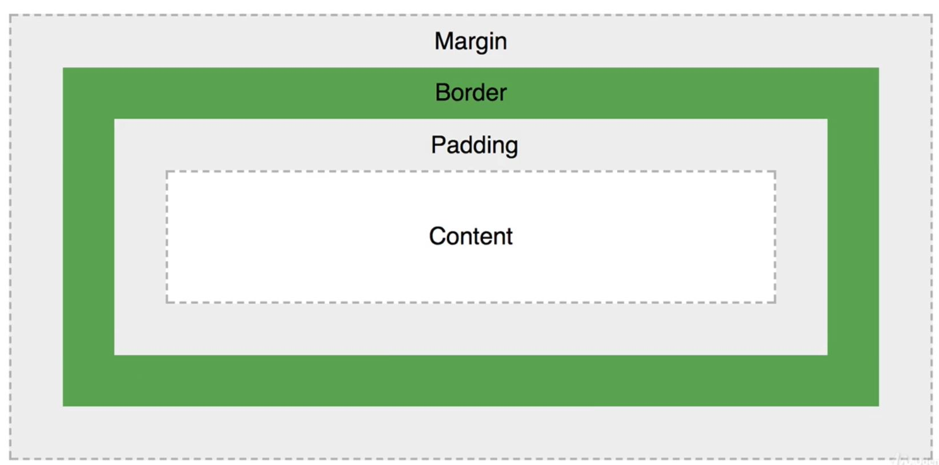
Box Model

Slide 24
Box Model Properties
Margin
Border
Padding
Content
Width & Height

Slide 25
Px vs Em vs Rem

Slide 26
Px vs Em vs Rem
There is more than one way to change the size of elements
PX - Standard way of Changing Sizes
EM - Size should be “x” times the CONTAININGelement
REM - Size should be “x” times the ROOT element

Slide 27
2.
Advanced CSS
Critical Render Path
Minification
Flexbox
CSS3
What properties can I use?
Responsive UI
Image Gallery (Example)
Robot (Challenge)
Froggy (Game)

Slide 28
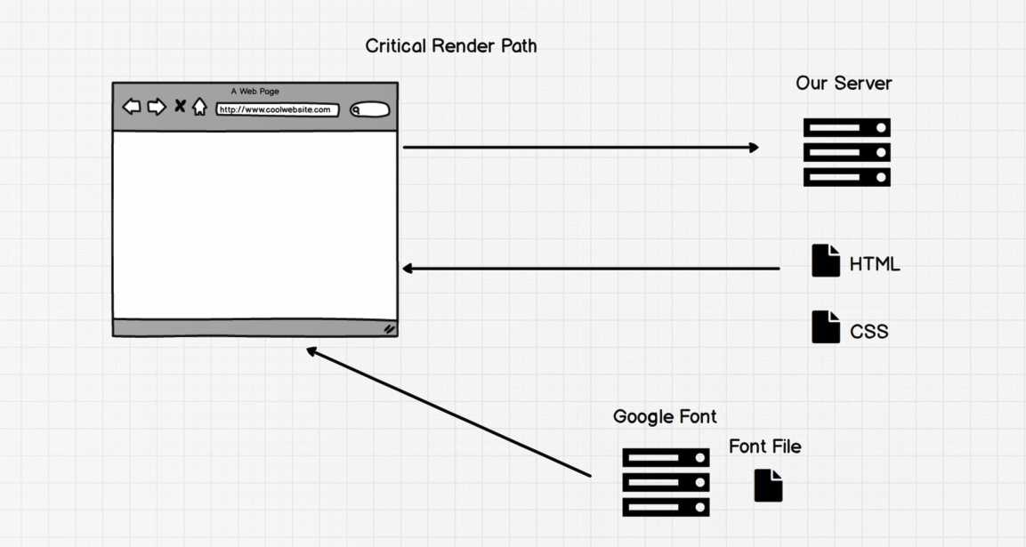
Critical Render Path
Notes:
The more dependencies you add the slower your website will be.

Slide 29
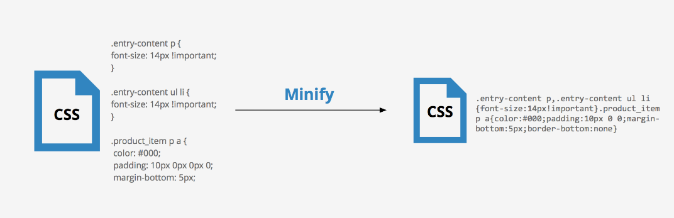
Minification

Slide 30
Flexbox
One of the difficult problem in CSS is to place elements in the location that we want.
Offers a solution to place elements in a location

Slide 31
Image Gallery
Demonstration

Slide 32
What Properties of CSS3 Can I Use?
CSS3 allowed website to be more dynamic BUT … Not all CSS3 Properties can be used
Browser wars made each browser work differently
Use this website to easily check
https://caniuse.com/

Slide 33
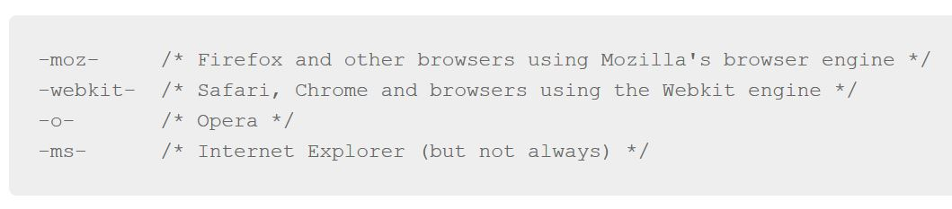
Vendor Prefixes

Slide 34
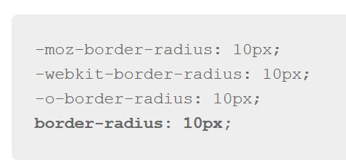
Vendor Prefixes
Browser prefixes are needed as browsers experiment and with newer implementations.
Make sure to put the non-prefixed version last

Slide 35
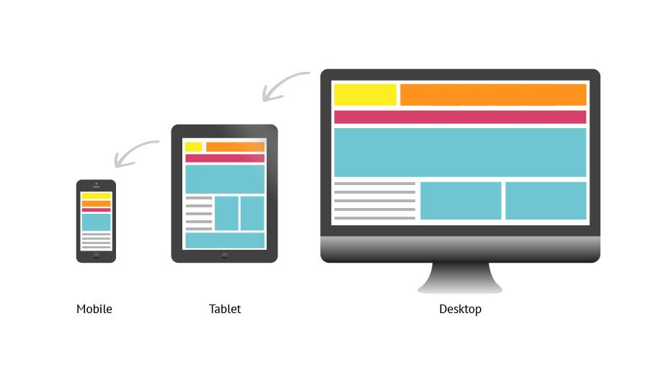
Responsive UI
Notes:
One of the first things your employer will ask is if your website is responsive
Responsive means that your website will look good no matter what size the screen is
Showcase Developer Tools - Phone Icone
Shows what the website will look like on different screen sizes

Slide 36
Robot Animation
Challenge

Slide 37
3.
Bootstrap 4 & Templates
Bootstrap Introduction
What’s a CDN?
Bootstrap 4
Putting Your Website Online
Personal Portfolio Landing Page (Challenge)

Slide 38
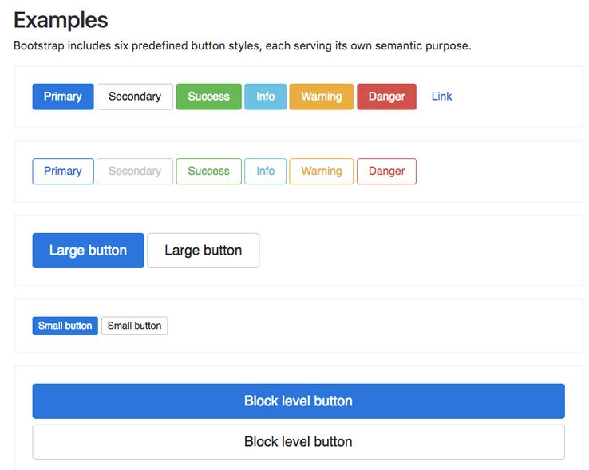
Introduction to Bootstrap
Writing CSS from scratch is a pain
Bootstrap components allow you to create websites faster
Notes:
Check out Bootstrap Components and showcase how many components Bootstrap Offers.

Slide 39
How to use Bootstrap?
Two ways to use the toolkit:
1. Download
Use a CDN (Content Delivery Network)
Be sure to put the JavaScript file at the BOTTOM of the <BODY> Tag

Slide 40
Won’t all my websites look the same?
Not necessarily.
You can edit the Bootstrap CSS by taking advantage of the Cascading Property

Slide 41
Bootstrap Grid
Best feature of Bootstrap is the Grid System
Primary Reason why Bootstrap is popular
Flexbox didn’t exist when Bootstrap came out
Easy to create Website Layouts

Slide 42
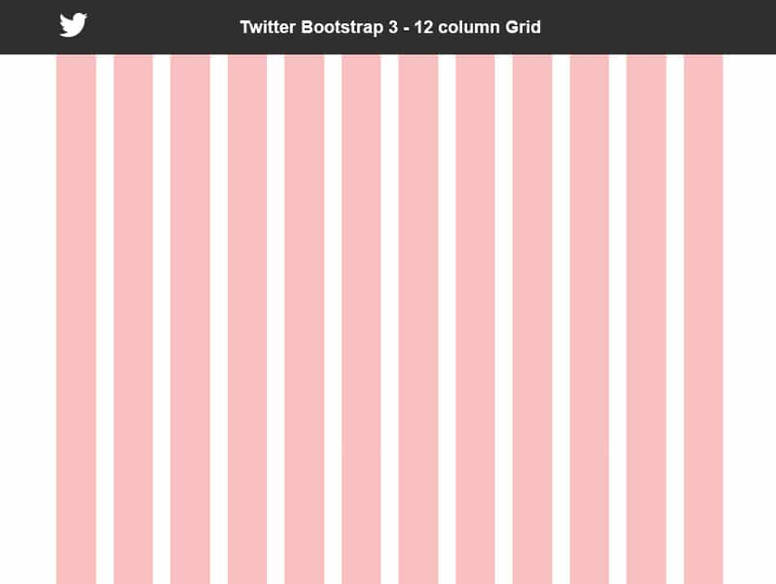
Bootstrap Grid Visualized

Slide 43
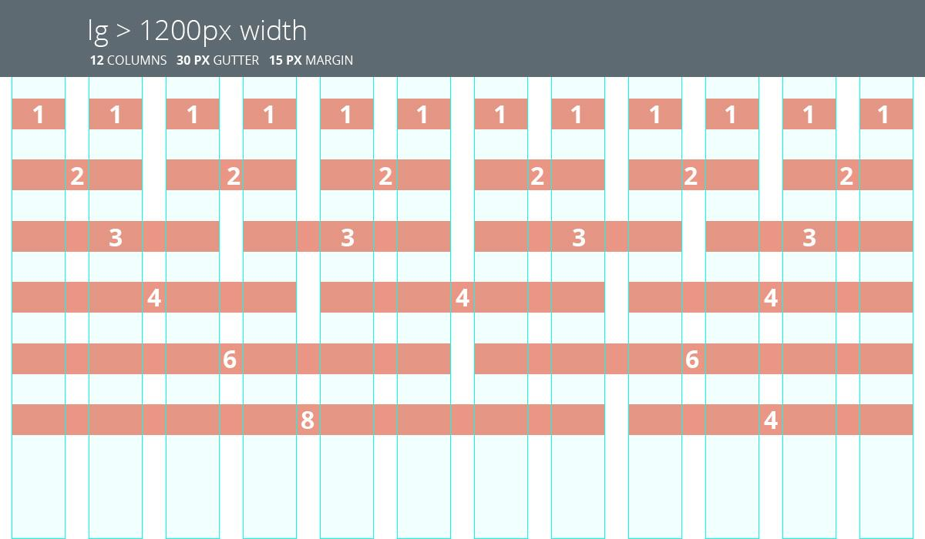
Bootstrap Grid

Slide 44
Personal Portfolio
Challenge

Slide 45
Thanks!
👍
Any questions?
You can find me at @JustinEstaris

